Slide 1
Historical traceability of the product structure development and related documents
As exemplified in the following pictures any changes should be traceable.
That means in the future you must be able to determine:
Which product structure existed at time X in the past (As tree structure (please see attached Excel-Table))
What documents existed at time X in the past related to the product structure at time X
Which versions of documents have been available since 07.2020 (these must be permanently (“forever”) available)
The installation version must also be stored here, i.e. the date must also be saved here.
→ there is a new platform release every 5 months, →[the new platform release is always 05 (May) and 11 (November) every year]
and every 2 months the sprint cycle in which the modules are further developed. →[always platform release + 2 months → all odd months of the year 01/03/05/07/09/11]
This means in summary that at least every two months a version of the product structure must be stored.
If there are changes between these periods a new version of the product structure must also be stored here
On a timeline for example, for the product structure this would look like this
A very important scenario for this application is for example the support. A customer who owns a software which (for various reasons) still has a 5 years old release status, must have the possibility to obtain the documents from this release status as well.
Furthermore the support must be able to trace which product structure has been used in a period of time to see what was connected to what.
You should also be able to trace what was sold at that time (e.g. a component was included in scenario free of charge in the past, but is now sold as a paid upgrade
(in this case, the customer would be entitled to the component during an upgrade, but a new customer would not))
etc, etc...
Solutions:
Retrievable copies of the product structure must be kept. (as soon as any change takes place)
The documents must all be permanently stored (practically without deleting old documents).
Documents must be stored in such a way that the latest version is always assigned to the current product structure
If an old version of the product structure is used, the old documents mapped to it must also be retrievable
in summary:
→ The product structure must be kept for each update (e.g. as a copy of the database → if you have a better idea here to implement the request, please tell us)
→ The documents must be kept in a continuous list, with all versions, but assigned to the respective product structures→ see the example on slide 7,8,9,10
01.07.2020
01.08.2020
01.09.2020
01.10.2020
01.11.2020
01.12.2020
01.01.2021
01.02.2021
01.03.2021
01.04.2021
01.05.2021
01.06.2021
01.07.2022
01.08.2022
01.09.2022
01.10.2022
01.11.2022
01.12.2022
01.01.2022
Version 001
Version 002
Version 003
Version 004
Vers. 005
Version 006
Version 007
Vers. 008
Vers. 009
V 010
Version 011
Version 012
Month
Version life cycle
Module Sprint
Platform release

Slide 2

Product structure – Naming of the product structure
The release date is used for naming the product structure.
For the version of the current period from 01.07.2020, this would be the PIM version:
PIM 20.07.01 ➔
Since a release change can also take place within the months, the day (01) should also be specified.
Within the tree structure, each element must be followed by the corresponding release date. → see the example on slide 4
This means that in the tables that describe the product structure we need an additional column in which we enter the product structure → see the example on the next page (slide 3)
The module table must be used to control the assignment of the version.
→ The scenarios depend on the platform release which is maintained in the module table (must be added as an element here)
→ The components are dependent on the module releases, which are also maintained in the module table.
In summary, this means that the maintenance only takes place in the module table (for the time being (but the possibility to override the automatic versioning in single elements must be given))
01.07.2020
01.08.2020
01.09.2020
01.10.2020
01.11.2020
01.12.2020
01.01.2021
01.02.2021
01.01.2022
PIM 20 07 01
PIM 20 09 01
PIM 20 11 01
PIM 21 01 01
PIM 21 02 07
Dependent table
Scenarios
MAIN TABLE
Modules + Platform
Dependent table
Components
The Main<->Dependent relationship described here, applies ONLY to the release assignment to realize the versioning

Slide 3
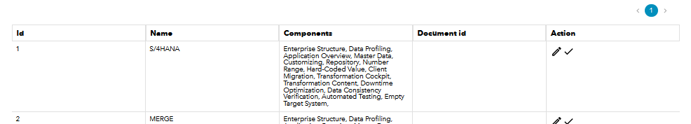
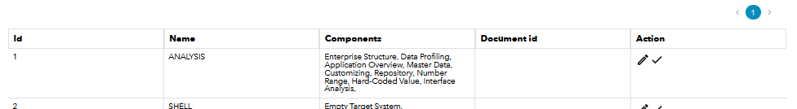
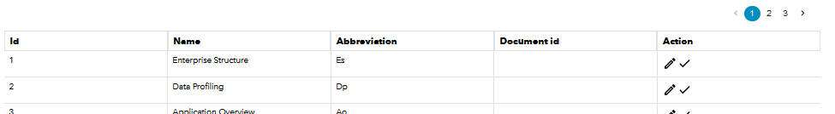
Product structure
Add column platform release -> depending on the platform release
Add column scenario version
Scenarios
Modules
Add column platform release
Add column module release
MAIN TABLE
Add the element Platform
Components
Add column platform release -> depending on the platform release
Add column module release -> depending on the Modul release
Add column component release

Slide 4
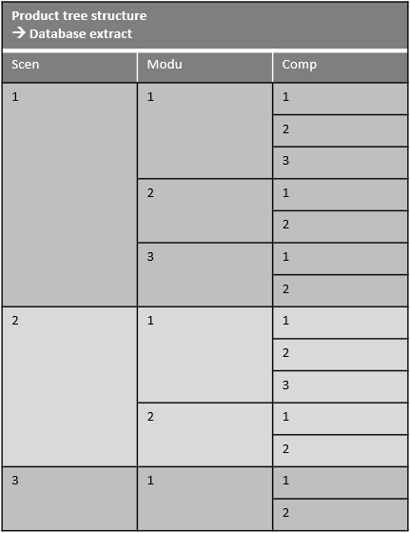
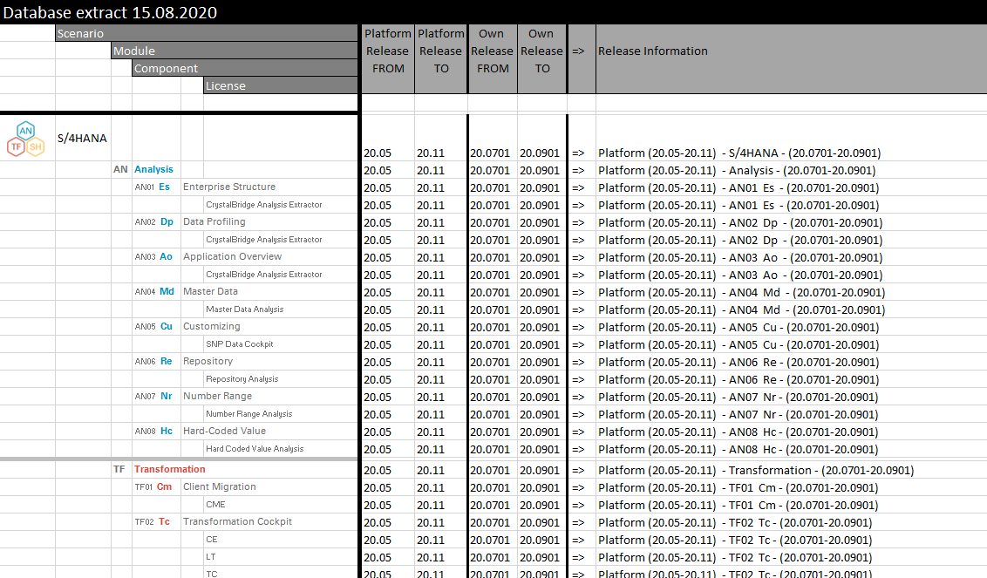
Product structure – Tree-structure database extract example
Scheme
Example
This example shows how a database extract
of the date 15.08.2020 would look like
When it is retrieved e.g. in 2021
This is the required database extract, for now this is independent of the documents

Slide 5
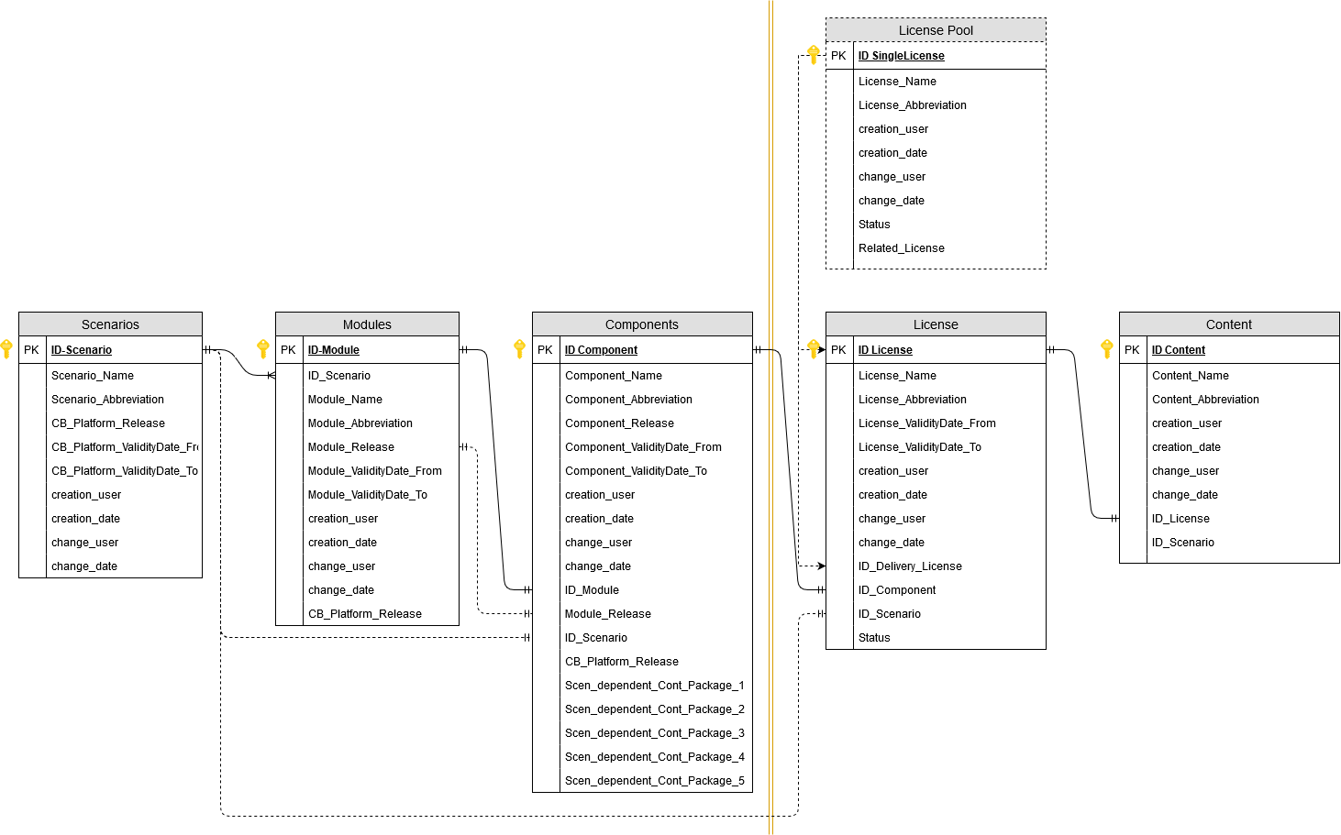
Product structure – Tree-structure database extract – used fields

Slide 6
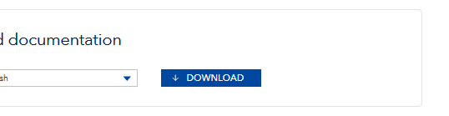
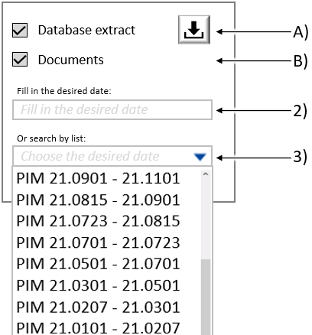
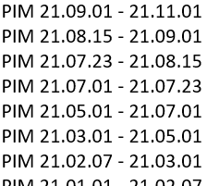
Product structure – How the user gets the data
1) The first method is the user uses the full overview of the PIM 2.0 and searches e.g. in the column creation date directly for the required document in the required version.
2) With the second method there must be the possibility to enter a date (free date, no matter when) in a field and the user is directly shown the corresponding database version and all related documents of this date.
3) With the third method the user must have the possibility to choose from a list (default is the current date)
Use the checkboxes to select which historical function you want to use.
With Database Extract you select that you want to have the database extract in tree structure as an Excel table.
With the download button behind it you can download it. As long as no entry has been made in the fields 1 & 2 the download button remains greyed out and inactive.
If you activate the checkbox B you can download documents with the normal PIM as usual, but from the period of time mentioned below.
Activating this historical download has to be made visible somewhere with a hint.
As an example you could place it here, but please decide where it fits best from the design aspect.
Also the design itself is up to you, only the functionality must be given.

Slide 7
Short example
Documents
Product structure Version 1
(Tree)
Dokument Name | Version | Example value 1 | further attributes……
Document 1 | Version 1.0 | Example value 1 | ……
Document 1 MoreNameText | Version 2.0 | Example value 1 | ……
Document 2 | Version 1.0 | Example value 1 | ……
Document 2 | Version 2.0 | Example value 1 | ……
Document New Comp. | Version 1.0 | Example value 1 | ……
Document 3 | Version 1.0 | Example value 1 | ……
Document 3 | Version 1.1 | Example value 1 | ……
Document 3 | Version 1.2 | Example value 1 | ……
Document 3 | Version 2.0 | Example value 1 | ……
Document 3 | Version 3.0 | Example value 1 | ……
Document 3 | Version 4.0 | Example value 1 | ……
Document 4 | Version 1.0 | Example value 1 | ……
Product structure Version 2
(Tree)
Product structure Version 3
(Tree)
Product structure Version 4
(Tree)
Product structure Version 5
(Tree)
It must be possible, depending on the database structure version, to package and download the corresponding documents.
It must also be possible to search for release versions in the refined display of the PIM 2.0

Slide 8
Short example description:
Documents
For example, it must be possible on 01.07.2025 to trace which product structure existed on 08.12.2020 and which documents belonged to it.
Dokument Name | Version | Example value 1 | further attributes……
Document 1 | Version 1.0 | Example value 1 | ……
Document 1 MoreNameText | Version 2.0 | Example value 1 | ……
Document 2 | Version 1.0 | Example value 1 | ……
Document 2 | Version 2.0 | Example value 1 | ……
Document New Comp. | Version 1.0 | Example value 1 | ……
Document 3 | Version 1.0 | Example value 1 | ……
Document 3 | Version 1.1 | Example value 1 | ……
Document 3 | Version 1.2 | Example value 1 | ……
Document 3 | Version 2.0 | Example value 1 | ……
Document 3 | Version 3.0 | Example value 1 | ……
Document 3 | Version 4.0 | Example value 1 | ……
Document 4 | Version 1.0 | Example value 1 | ……
01.11.2020
Existence period of this specific version
Product structure Version 3
(Tree)
01.01.2021

Slide 9
Short example (another example with structure version 5)
Documents
Dokument Name | Version | Example value 1 | further attributes……
Document 1 | Version 1.0 | Example value 1 | ……
Document 1 MoreNameText | Version 2.0 | Example value 1 | ……
Document 2 | Version 1.0 | Example value 1 | ……
Document 2 | Version 2.0 | Example value 1 | ……
Document New Comp. | Version 1.0 | Example value 1 | ……
Document 3 | Version 1.0 | Example value 1 | ……
Document 3 | Version 1.1 | Example value 1 | ……
Document 3 | Version 1.2 | Example value 1 | ……
Document 3 | Version 2.0 | Example value 1 | ……
Document 3 | Version 3.0 | Example value 1 | ……
Document 3 | Version 4.0 | Example value 1 | ……
Document 4 | Version 1.0 | Example value 1 | ……
07.02.2021
Existence period of this specific version
Product structure Version 5
(Tree)
01.03.2021

Slide 10
Short example description:
Documents
For example, it must be possible on 01.07.2025 to trace which product structure existed on 08.12.2020 and which documents belonged to it.
Dokument Name | Version | Example value 1 | further attributes……
Document 1 | Version 1.0 | Example value 1 | ……
Document 1 MoreNameText | Version 2.0 | Example value 1 | ……
Document 2 | Version 1.0 | Example value 1 | ……
Document 2 | Version 2.0 | Example value 1 | ……
Document New Comp. | Version 1.0 | Example value 1 | ……
Document 3 | Version 1.0 | Example value 1 | ……
Document 3 | Version 1.1 | Example value 1 | ……
Document 3 | Version 1.2 | Example value 1 | ……
Document 3 | Version 2.0 | Example value 1 | ……
Document 3 | Version 3.0 | Example value 1 | ……
Document 3 | Version 4.0 | Example value 1 | ……
Document 4 | Version 1.0 | Example value 1 | ……
01.11.2020
Existence period of this specific version
Product structure Version 3
(Tree)
01.01.2021
The product structure must be accessible via a separate function.
Here you can always call up the structure that was valid in a certain period of time, as shown here for 08.12.2020.
(period from 01.11.2020 to 01.01.2021)
The product structure is output in the form of a tree structure
(see also attached Excel table)
the documents are permanently (always all) available
(also via the refined search function in the PIM 2.0 version)
The documents are archived as a continuous additive database.
The versioning is realized here by means of the document's own version.

